Slide 1
DETECTING BUILDING DEFECTS USING CONVOLUTION NEURAL NETWORKS
Developed by:
KATKURI SRIJA; GOUDA KAVYA;
CHEEKATI KRISHNACHAITHANYA;
BURRA ARUNKUMAR,
INTRODUCTION
OVERVIEW:
This project deals with detecting the defects and spalls in buildings using Convolutional neural networks. With the help of this project the defects in buildings can be detected conveniently. This focuses on efficient building maintainence with reduced time and labour.
PURPOSE:
The major purpose of this project is set to investigate the novel application of deep learning method of convolutional neural networks (CNN) in automating the condition assessment of buildings. The focus is to automated detection and localisation of key defects arising from dampness in buildings from images. However, as the first attempt to tackle the problem, this project applies a number of limitations.

Slide 2
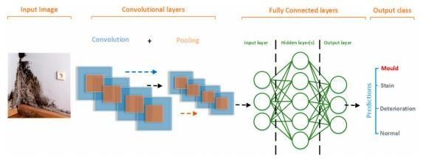
Firstly, multiple types of the defects are not considered at once. This means that the images considered by the model belong to only one category. Secondly, only the images with visible defects are considered. Thirdly, consideration of the extreme lighting and orientation, e.g., low lighting, too bright images are not included in this project.
PROPOSED SOLUTION
This era requires smart buildings. This proposed system is based on pre-trained CNN classiﬁer of VGG-16, with class activation mapping (CAM) for object localisation.
The challenges and limitations of the model in real-life applications have been
identiﬁed. The proposed system has proven to be robust and able to accurately detect and localise building defects. This approach is being developed with the potential to scale-up and further advance to support automated detection of defects and deterioration of buildings in real-time using mobile devices and drones. Where technology takes over manual work of building maintenance. This projects builds an application where it detects cracks and spalls in the buildings and helps in building maintenance.
THEORETICAL ANALYSIS:
BLOCK DIAGRAM:

Slide 3
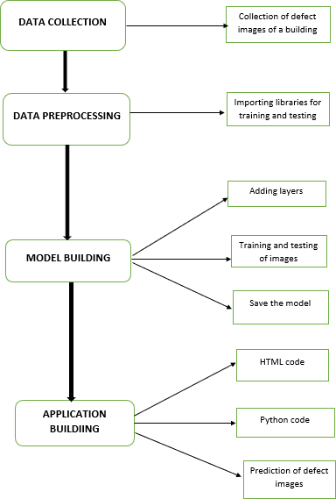
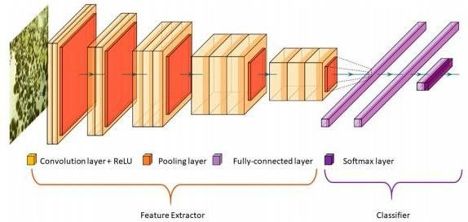

Slide 4
HARWARE/SOFTWARE DESIGN:
Hardware Design:
Hard Disk
Laptop
RAM-4GB
Sofware Design:
➤
➤
➤
Python 3.6
Jupyternotebook
Spyder ide
EXPERIMENTAL INVESTIGATIONS:
DATA COLLECTION
We have taken images of diﬀerent resolutions and sizes which were obtained from the internet. The data was labelled into three main categories. The total number of images used as training data was 257. The remaining 133 images

Slide 5
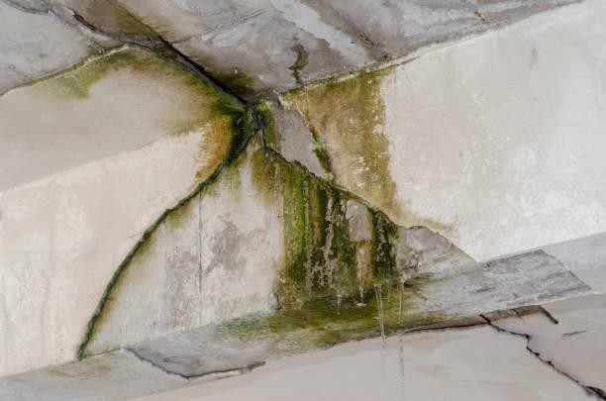
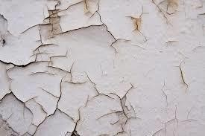
DATA PREPROCESSING:
from keras.preprocessing.image import ImageDataGenerator
train_datagen=ImageDataGenerator(rescale=1./225,shear_range=0.2,zoom_range= 0.2,horizontal_flip=True)
test_datagen=ImageDataGenerator(rescale=1./225)
Here we are importing the ImageData generator to train and test the images dataset.

Slide 6
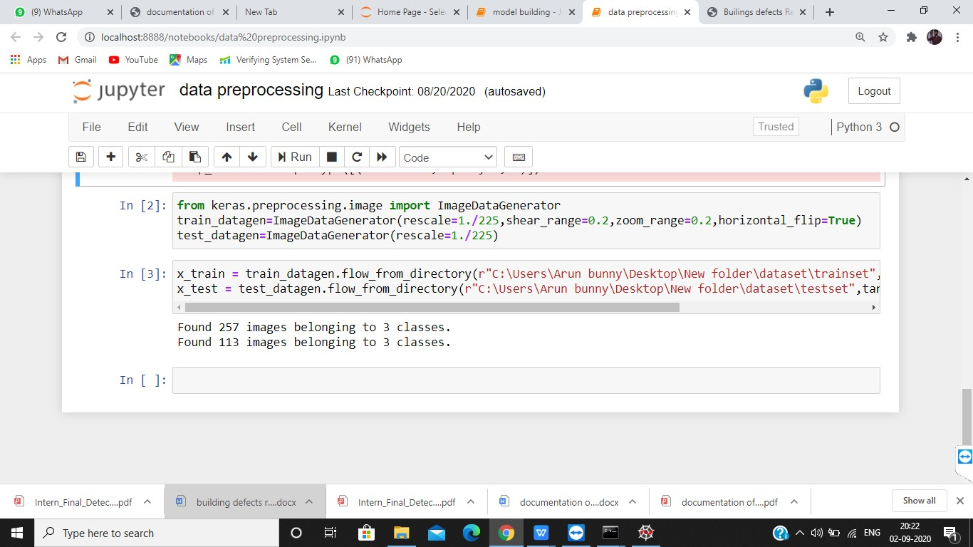

Slide 7
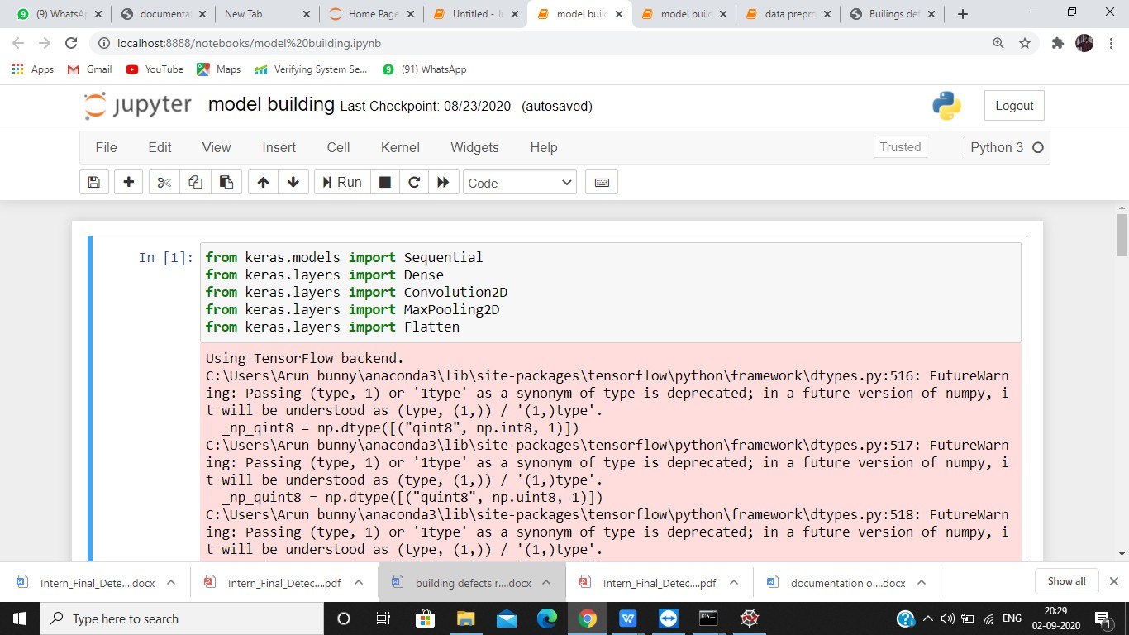
MODEL BUILDING:from keras.models import Sequential from keras.layers import Dense
from keras.models import Sequential from keras.layers import Dense
from keras.layers import Convolution2D from keras.layers import MaxPooling2D from keras.layers import Flatten
The layers are imported along with the activation function for the training and test validation of the images.

Slide 8
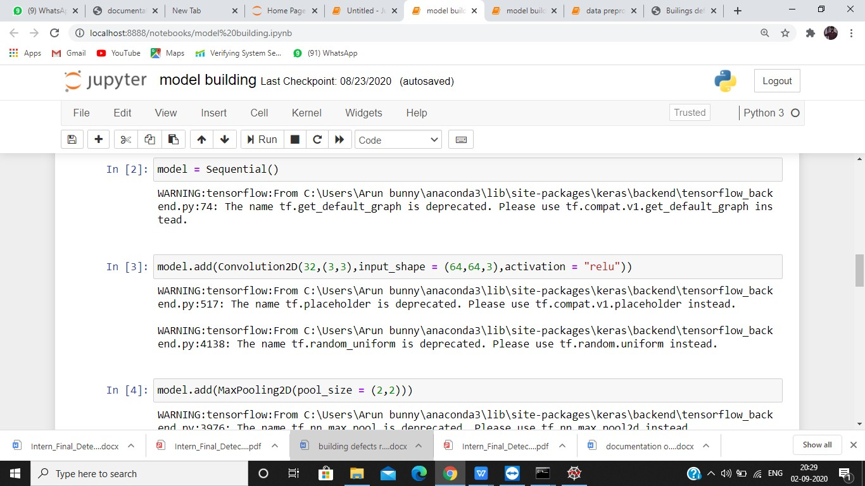
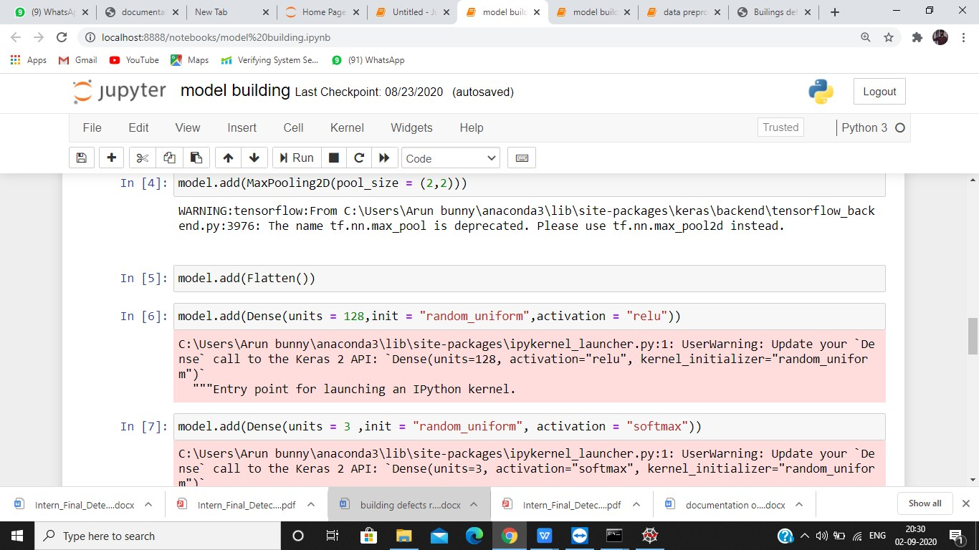

Slide 9
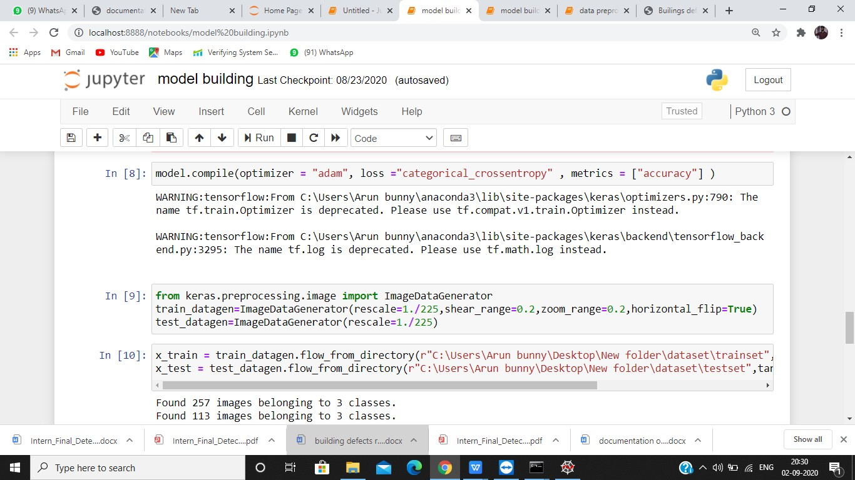
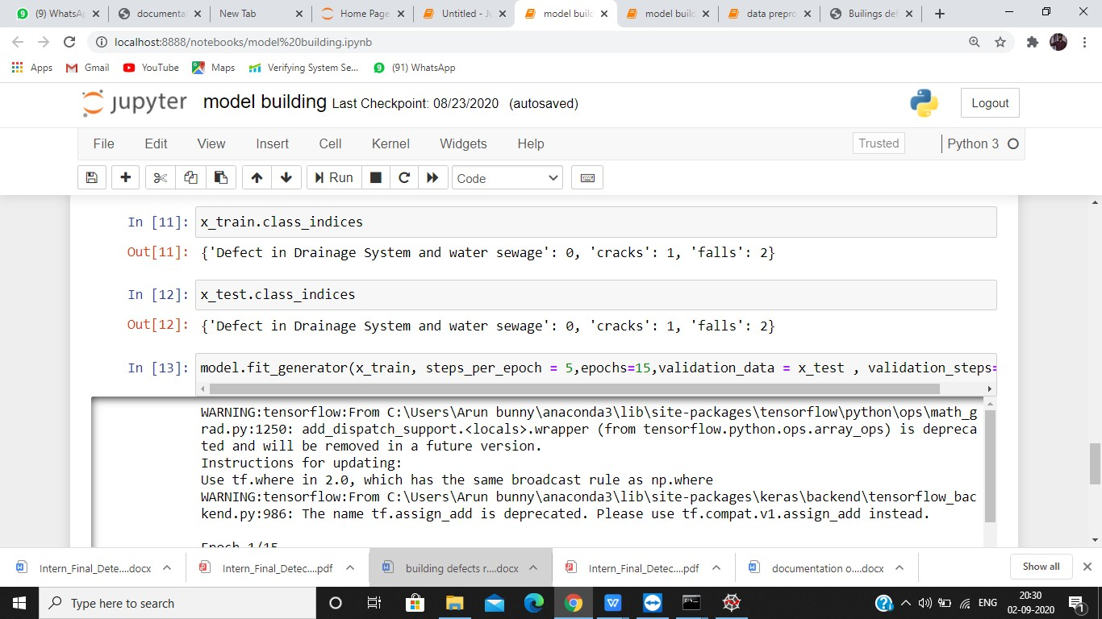

Slide 10
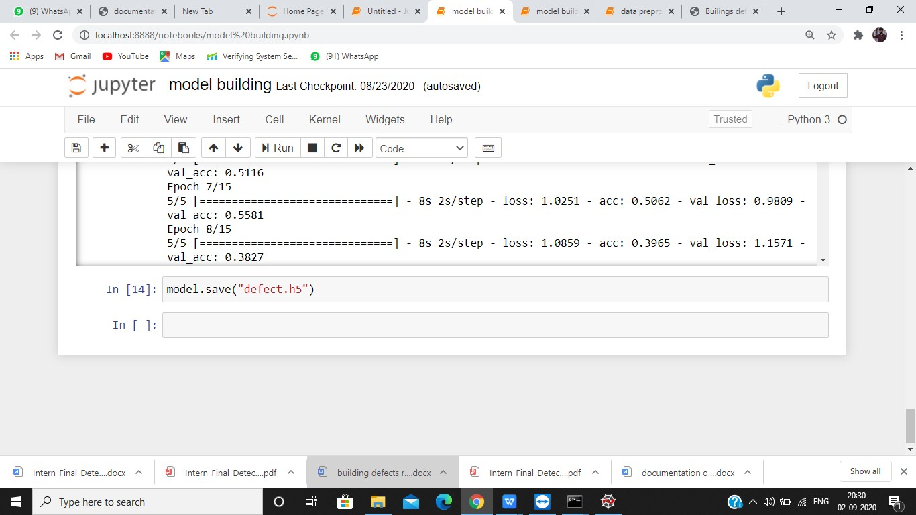

Slide 11

RESULT:
CNN algorithm is used to recognize the image uploaded and predict the result. The css used here is internal css and spyder ide has been used.

Slide 12

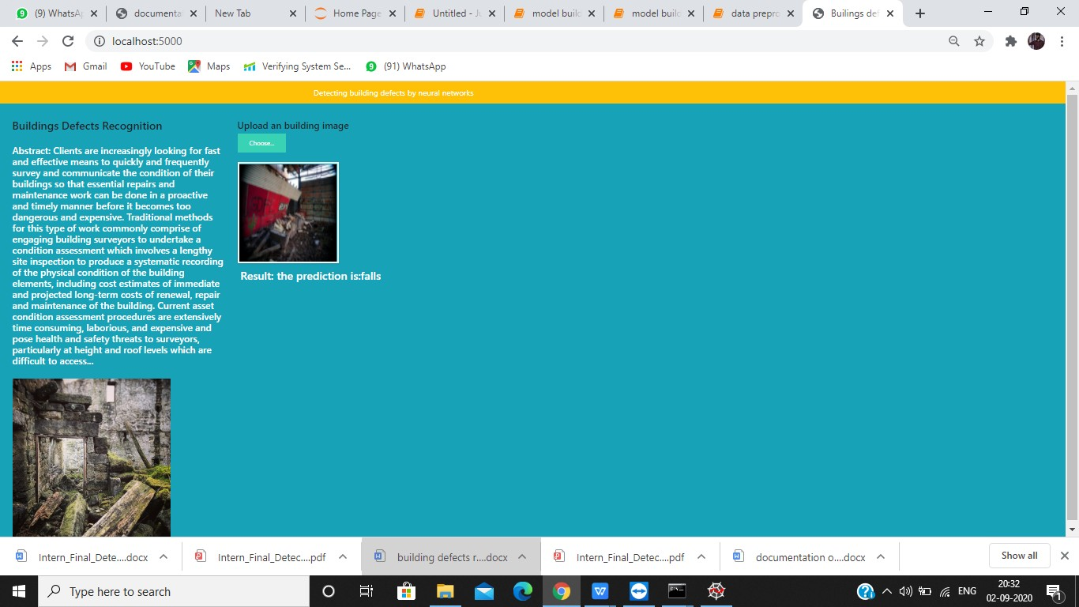

Slide 13
ADVANTAGES AND DISADVANTAGES
ADVANTAGES:
The main advantage is that it automatically detects the important features without any human supervision.
Classification of the defect can be predicted.
High reliability and robustness in classifying and localising the defects.
Man power for defecting defect is reduced5.Frequent monerating of any type of defect in the building is reduced.
DISADVANTAGES:
1.There may be slit chances of error while predicting the images 2.Detection is difficult when there so many similar images 3.Classification of images is similar so it is difficult to detect
APPLICATIONS:
4. It can be used in detecting the defect in the house. 2.It is very useful in buildings,companies.
It is customizable by any type of person.
Building can be virtually projected and spots can be defected.
The application can be modified for portability in such a way that smart
phone cameras can be used to detect the defects or modified for drones for a complete survelience for a defects
CONCLUSION:
The work is concerned with the development of a deep learning-based method for the automated detection and localisation of key building defects from given images. This project is part of work on condition assessment of built assets.

Slide 14
FUTURE SCOPE:
Future scope is simply focus only on detecting cracks on concrete surfaces which is a simple binary classiﬁcation problem, we oﬀer a method to build a powerful model that can accurately detect and classify multi-class defects given are latively very small datasets. In the future works, these limitations will be considered to be able to get closer to the concept of a fully automated detection. Through fully satisfying these challenges and limitations, our present work will be evolved into a software application to perform real-time detection of defects using vision sensors including drones. The work will also be extended to cover other models that can detect other defects in construction such as cracks, structural movements, spalling and corrosion. Our long- term vision includes plans to create a large, open source database of diﬀerent building and construction defects which will support world-wide research on condition assessment of built assets.

